Slide 1
Automated Training Data Generation for Geometrical Machine Learning
Final-Goal Calibration Presentation
Team: nullPointer
Team member: Allen Jiang, Bryant Porras, Kuanren Qian, Shu You, Vimalesh Vasu

Slide 2
Current progress (~70%)
Updated Pipeline
Clickdraw Interface
Work in progress
Old Pipeline
Mesh generation (3D)
Mesh generation (2D)
Completed
CFD simulation (3D)
Mesh Display
Work in progress
Batch simulation
Generate and run batch simulation (axis-symmetry)
Completed
GUI visualization
Work in progress
GUI visualization

Slide 3
Clickdraw (Work in progress)
Present a interface for the user to create their own mesh, by interactively adjusting the parameters which define the vacuum nozzle
Method of interaction (at the moment) is to define the end control points for the arcs which make nozzle mesh, and user inputs the remaining control point, and user clicks to confirm final mesh
Will also include a scale to show user what the actual dimensions of the nozzle are
May choose to include additional adjustable parameters
Expected to be completed
Notes:
Other potential methods of interaction include: clickndrag the third control pt
Other things to keep in mind: how use can input a range for parameters for batch sim

Slide 4
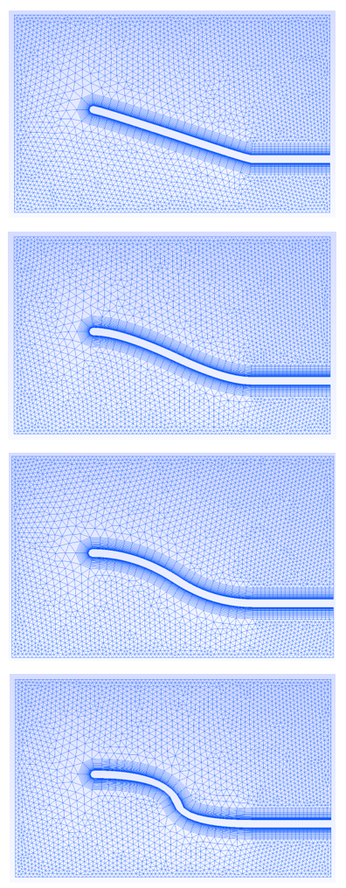
2. Mesh generation (Completed)
>.\genMesh.exe <radius> <num_samples>
Define Geometry
Create various nozzle shapes with user defined constraints.
Nozzle wall: Bezier Curve
By changing control points of Bezier curves.
Generate Mesh
Uses Gmsh C++ API, a popular open source mesh generator.
Group and label boundary conditions (for simulation in the next stage)
Delaunay Triangulation + boundary layer mesh.
Export generated mesh in NASTRAN Bulk Data format.
Supported by most of the simulation packages.

Slide 5
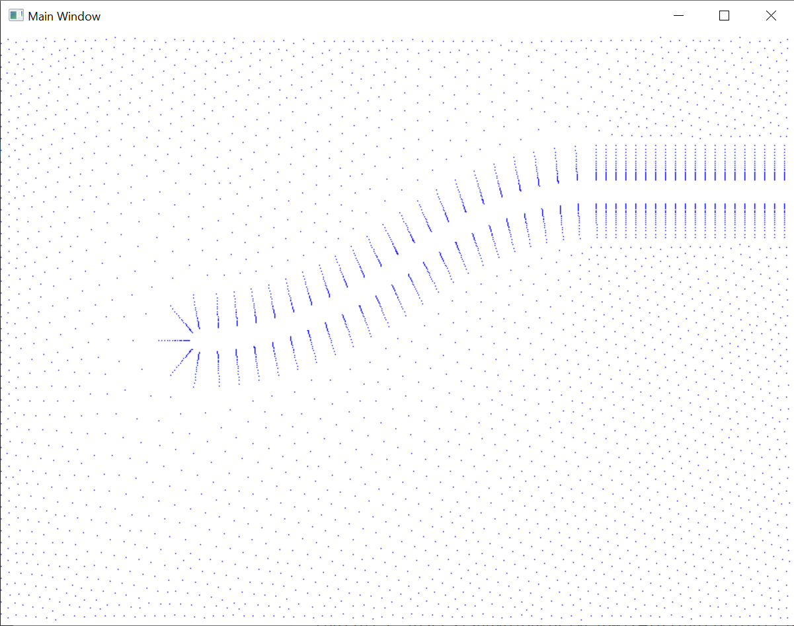
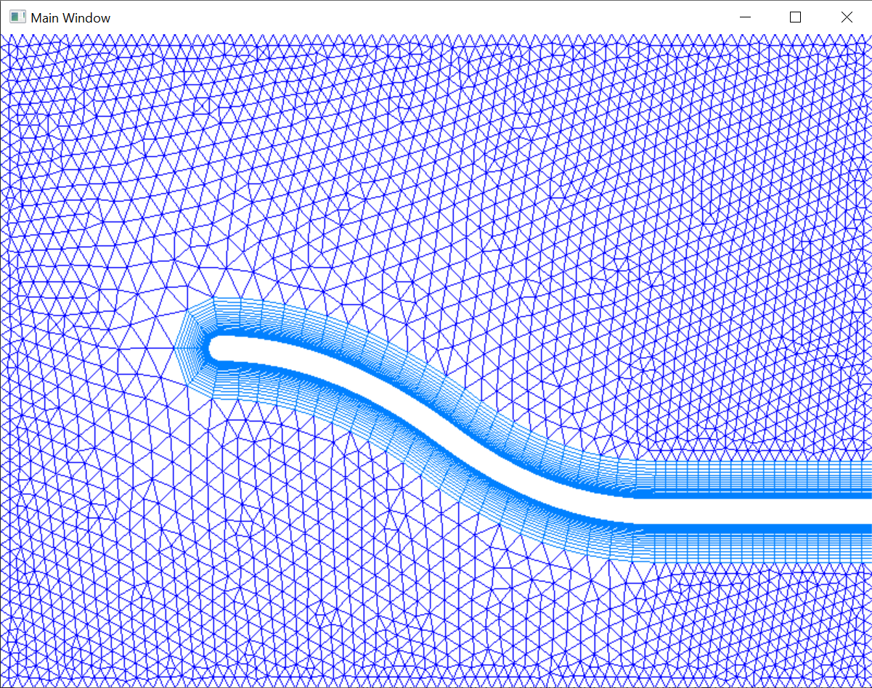
3. Mesh Visualization (Completed)
Used a .bdf file as input, implemented for line in lines.split() from Python in C++.
GRID 1 0 80.0000050.000000.00E+00
CTRIA3 523 11 3647 3610 3689
CQUAD4 6401 11 1160 1161 1261 1260
Extracted all data points and drew corresponding polygons according to vertex indices, using glDraw from fssimplewindow.h
Split 80.0000050.000000.00E+00 to 80,50,0
Triangle No.523 gets vertices No.3647,3610,3689
Polygonal mesh class still WIP

Slide 6
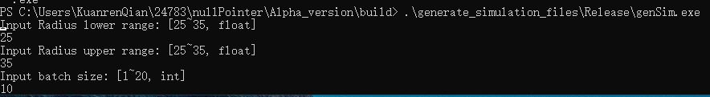
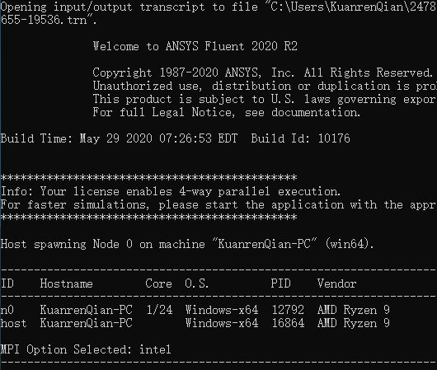
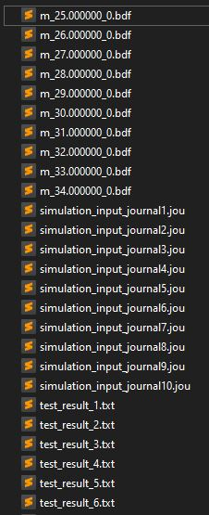
4. Generate and run batch simulation (Completed)
Automated Fluent journal input generation and batch simulation
From radius input to pressure/velocity results
Fluent journal file
uses texts user interface (TUI commands)
Specifies simulation parameters
Use system() to call genMesh.exe and Fluent
Complications with command line format
Gmsh modifies the process space
Had to make genMesh into exe
Call program
User input
Generate mesh and Invoke Fluent
Generated results

Slide 7
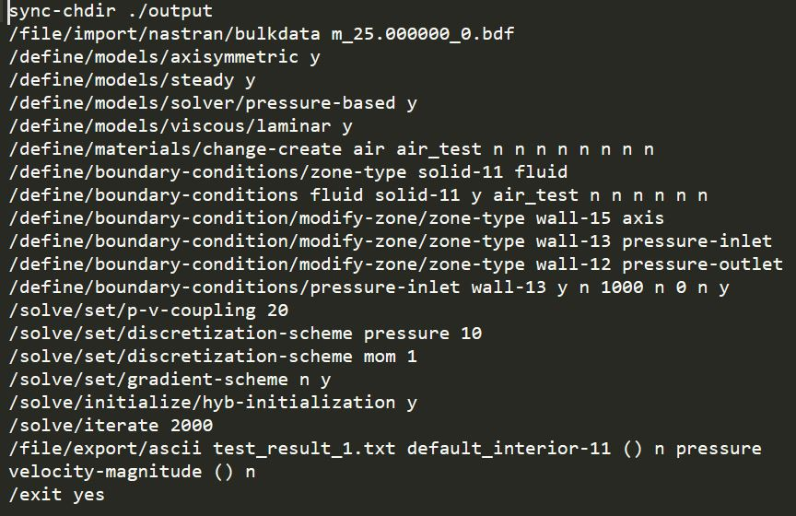
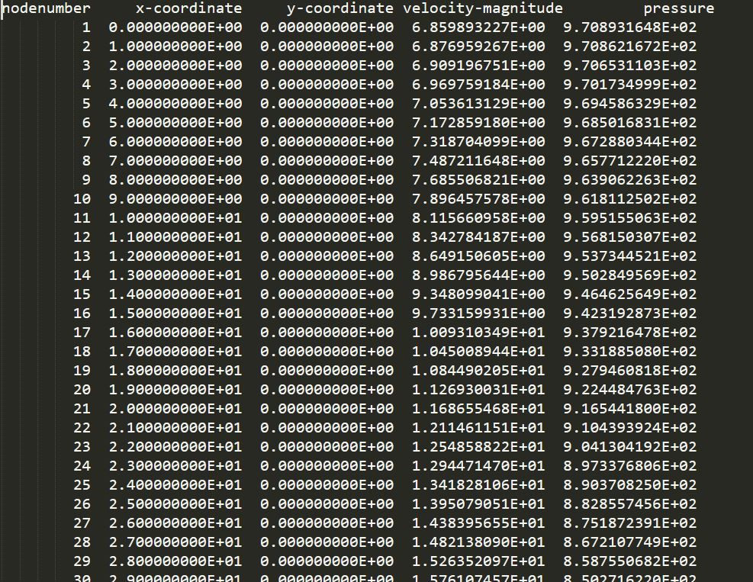
4. Generate and run batch simulation (Completed)
simulation_input_journalXX.jou
test_result_XX.txt

Slide 8
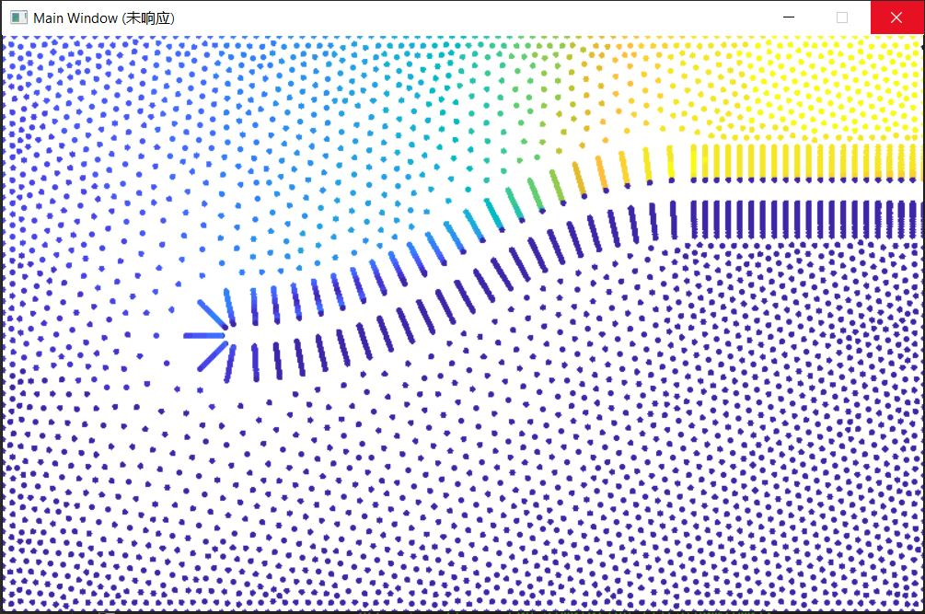
5. GUI visualization (Work in progress)
Read Fluent simulation results file into vtx2d and col2d
Missing element connectivity information
Fluent only export nodal values
Convert grayscale (pressure or velocity) back to RGB using predefined colormap
Adding color bar in the future
Adding side-by-side visualization in the future

Slide 9
Questions?

